Slide 1
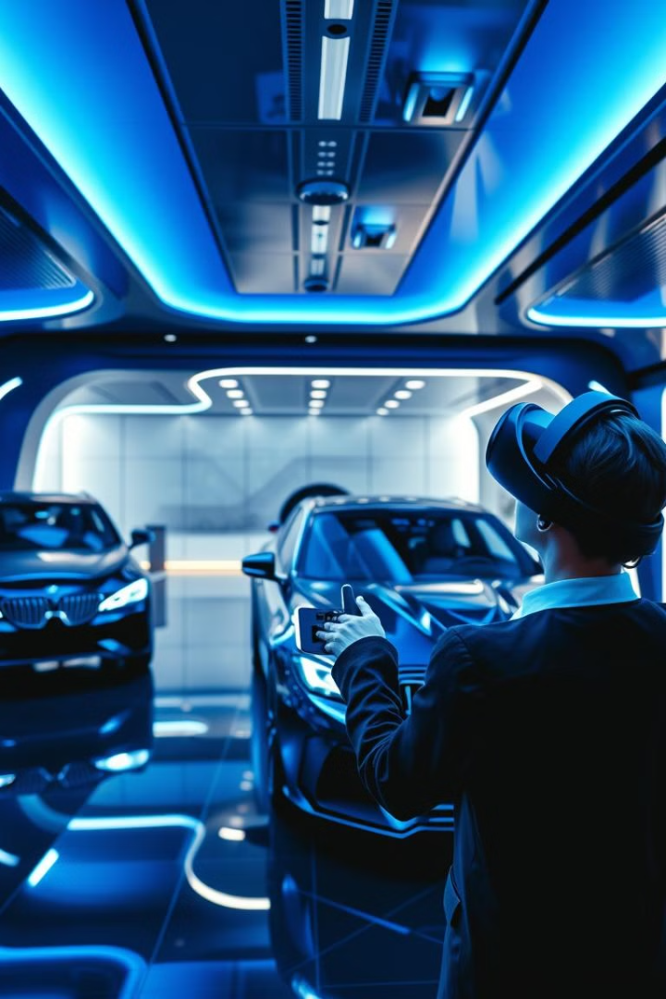
VR Car Showroom: A Virtual Automotive Exploration
Step into the future of car buying with our immersive VR showroom. Explore, customize, and test drive your dream car from the comfort of your own home.

Slide 2
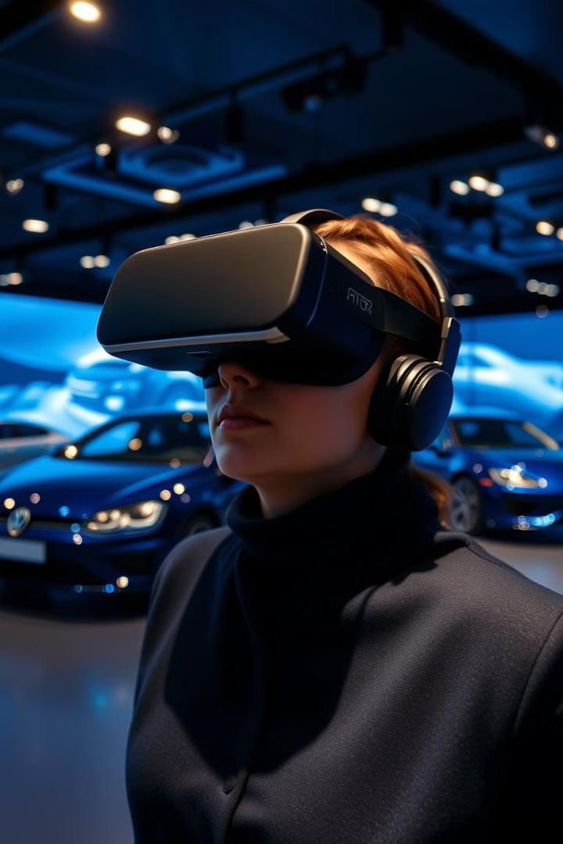
Revolutionize the Retail Experience
1
Convenience
2
Engagement
Shop for cars anytime, anywhere.
Interactive experience keeps customers engaged.
3
Accessibility
4
Efficiency
Reach a wider audience, beyond geographical limitations.
Reduce the need for physical showrooms and streamline the buying process.

Slide 3
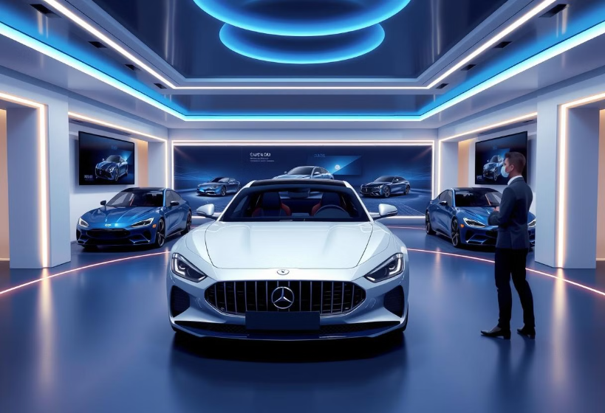
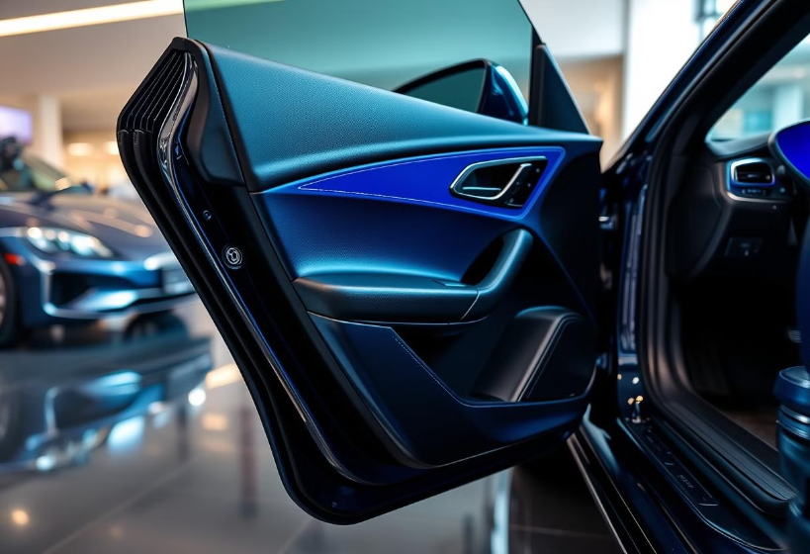
Immersive Virtual Showroom
Realistic Environments
Interactive Elements
Explore various car models in a lifelike virtual showroom.
Interact with vehicles, open doors, and explore the interior.

Slide 4
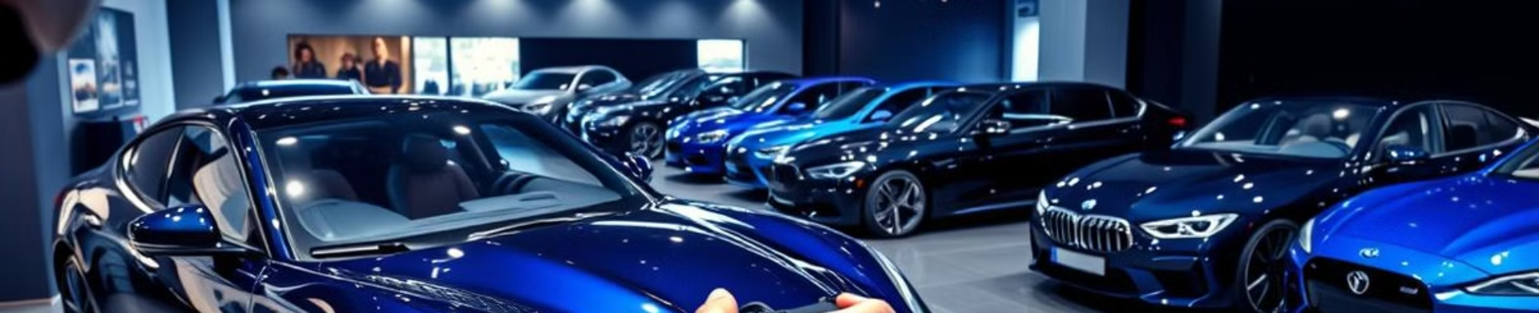



Explore the Latest Vehicle Models
Browse Inventory
Detailed Information
Compare Models
Discover the latest car models from various manufacturers.
View specs, features, and pricing information.
Side-by-side comparisons for informed decisions.

Slide 5
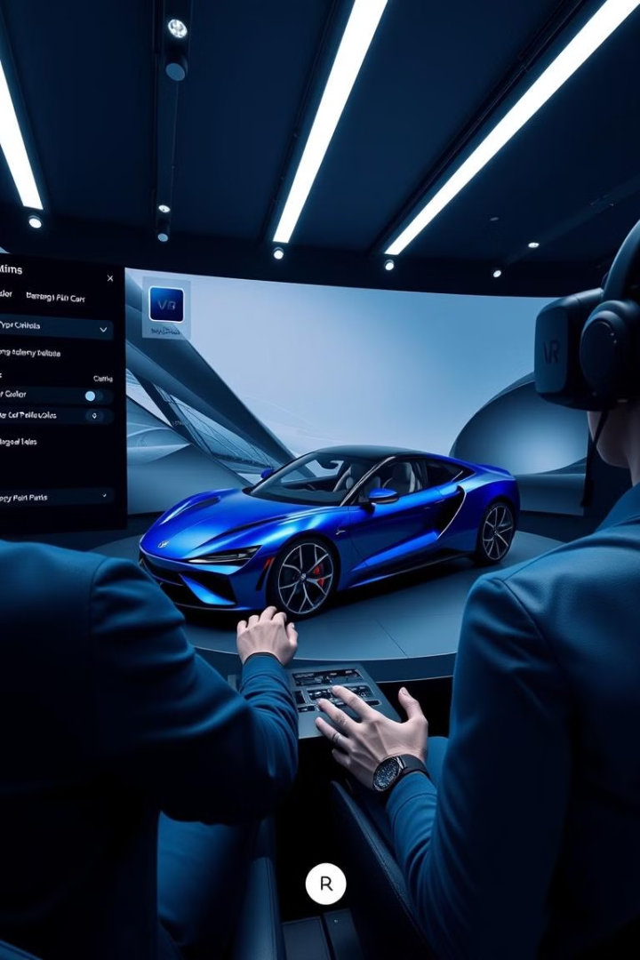
Personalized Customization Options
Exterior
Interior
Choose paint colors, wheels, and exterior features.
Select upholstery, trims, and interior features.
Performance
Customize engine and transmission options.

Slide 6
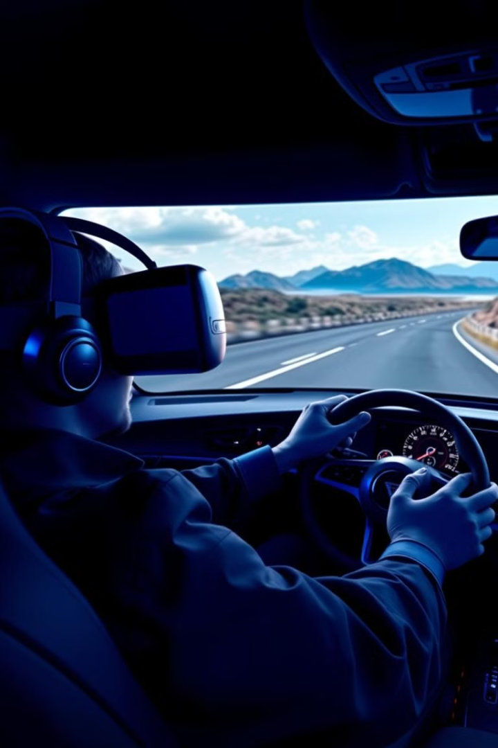
Interactive Test Drive Simulations
1
Realistic Physics
Experience the feel of the road and the car's handling.
2
Various Environments
Test drive in different settings, from city streets to open highways.
3
Personalized Settings
Adjust driving conditions and vehicle settings.

Slide 7
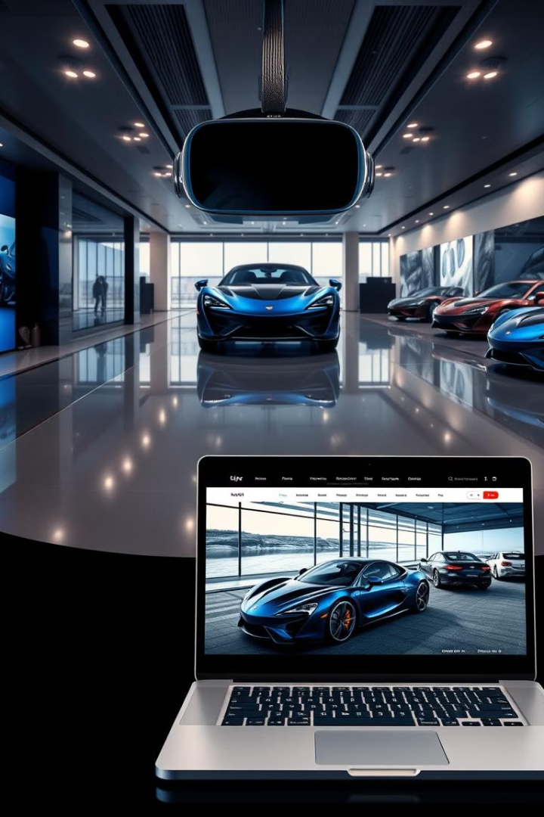
Seamless Omnichannel Experience
VR Showroom
Website
Immersive exploration and test drives
Detailed information and online configuration
Personalized recommendations
Secure payment and financing options

Slide 8
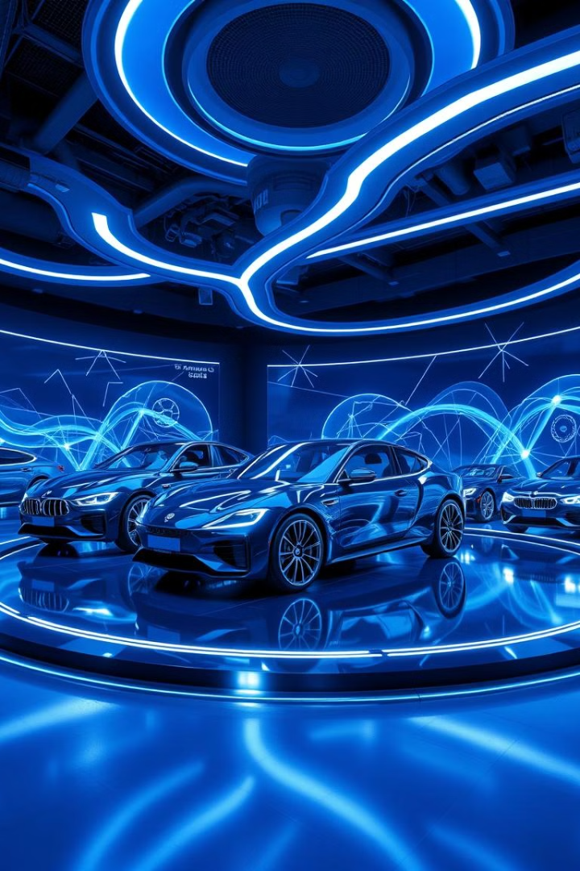



The Future of Automotive Retail
Enhanced Customer Experience
Personalized and engaging interactions.
Increased Efficiency
Streamlined processes and reduced costs.
Expanded Reach
Reaching customers worldwide.

